Slide 1
Basic Electronics
Things to be covered:
What is electricity
Voltage, Current, Resistance
Ohm’s Law
Capacitors, Inductors
Semiconductors
Mechanical Components
Digital Electronics

Slide 2
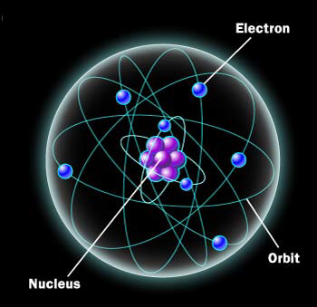
What is Electricity
Everything is made of atoms
There are 118 elements, an atom is a single part of an element
Atom consists of electrons, protons, and neutrons

Slide 3
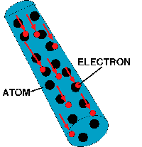

Electrons (- charge) are attracted to protons (+ charge), this holds the atom together
Some materials have strong attraction and refuse to loss electrons, these are called insulators (air, glass, rubber, most plastics)
Some materials have weak attractions and allow electrons to be lost, these are called conductors (copper, silver, gold, aluminum)
Electrons can be made to move from one atom to another, this is called a current of electricity.

Slide 4
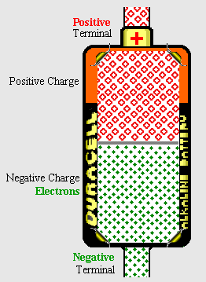
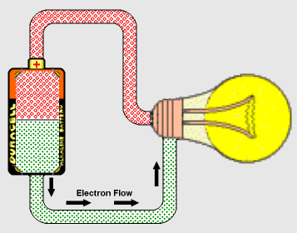
Surplus of electrons is called a negative charge (-). A shortage of electrons is called a positive charge (+).
A battery provides a surplus of electrons by chemical reaction.
By connecting a conductor from the positive terminal to negative terminal electrons will flow.

Slide 5
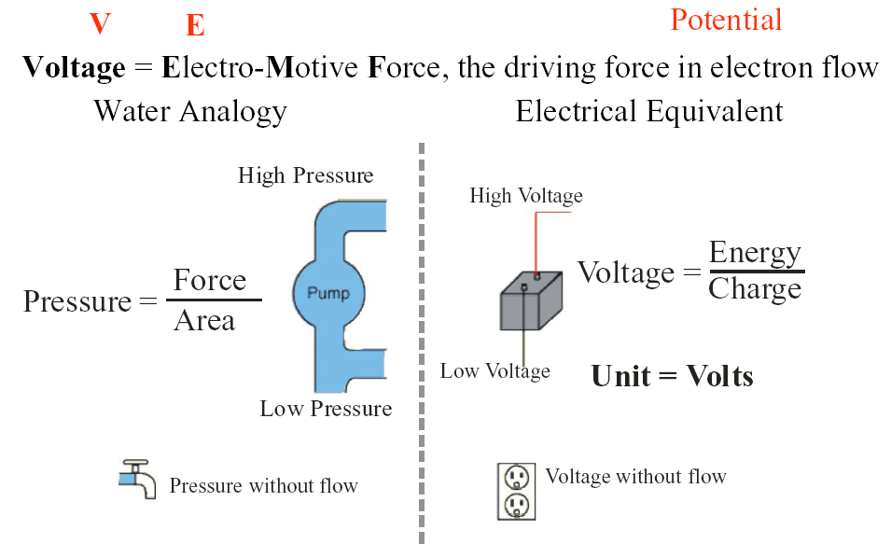
Voltage
A battery positive terminal (+) and a negative terminal (-). The difference in charge between each terminal is the potential energy the battery can provide. This is labeled in units of volts.
Water Analogy

Slide 6
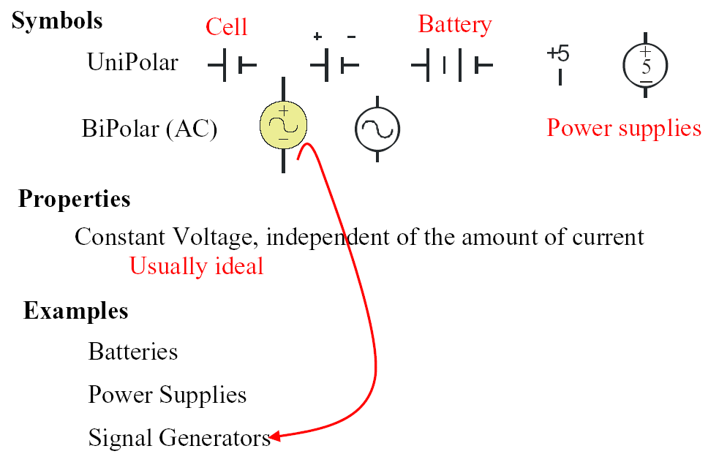
Voltage Sources:

Slide 7
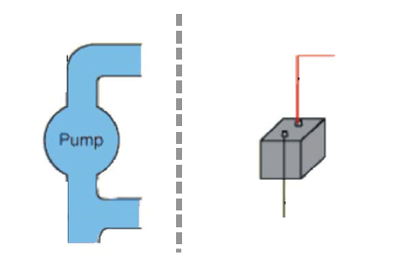
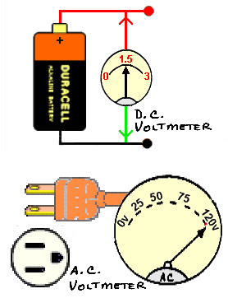
Voltage is like differential pressure,
always measure between two points.
Measure voltage between two points
or across a component in a circuit.
When measuring DC voltage make
sure polarity of meter is correct,
positive (+) red, negative (-) black.

Slide 8
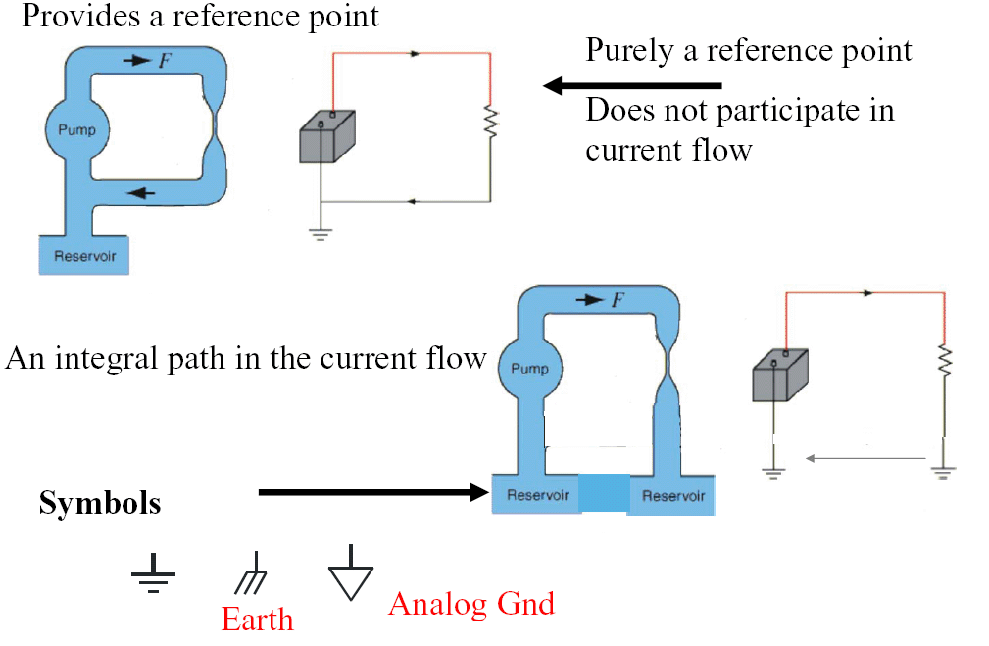
Ground

Slide 9
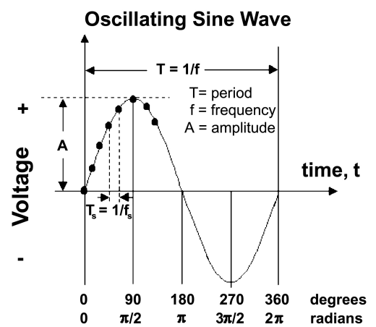
Exercise
Measure DC voltage from power supply using multimeter
Measure DC voltage from power supply using oscilloscope
Measure DC voltage from battery using multimeter
Measure AC voltage from wall outlet using a multimeter
Measure AC voltage from wall outlet using an oscilloscope
Effective or Root Mean Square Voltage
(Measured with multimeter)
ERMS=0.707xEA
E

Slide 10
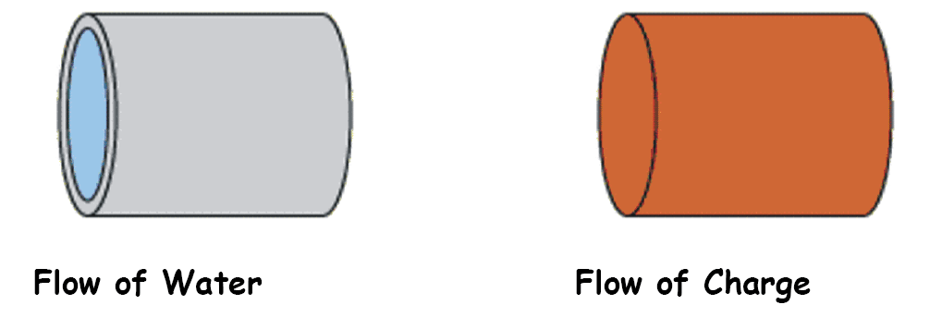
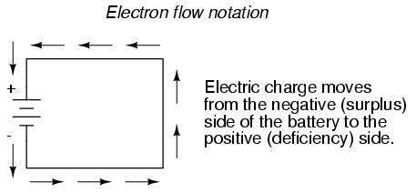
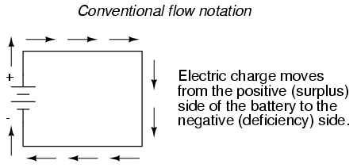
Current
Uniform flow of electrons thru a circuit is called current.
WILL USE CONVENTIONAL FLOW NOTATION ON ALL SCHEMATICS

Slide 11
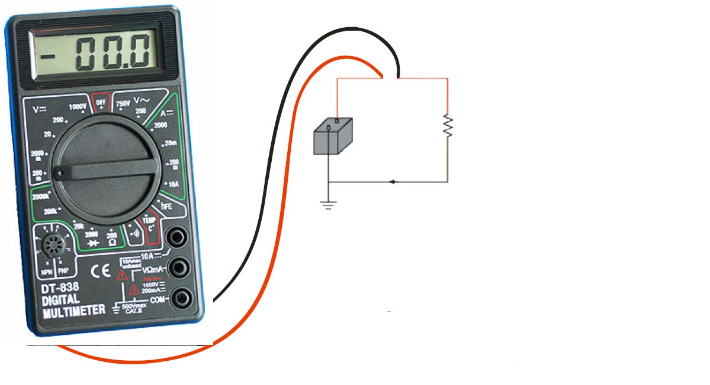
To measure current, must break circuit and install meter in line.
Measurement is imperfect because of voltage drop created by meter.

Slide 12
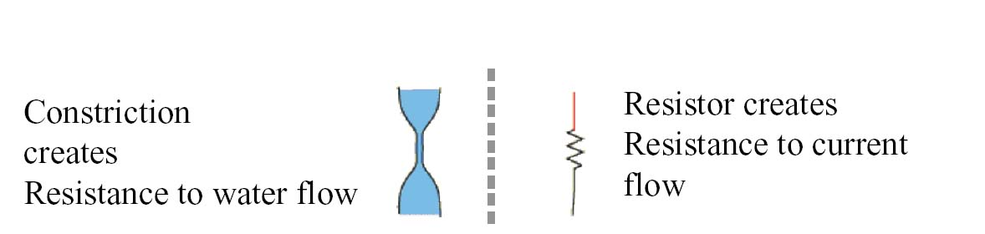

Resistance
All materials have a resistance that is dependent on cross-sectional area, material type and temperature.
A resistor dissipates power in the form of heat

Slide 13
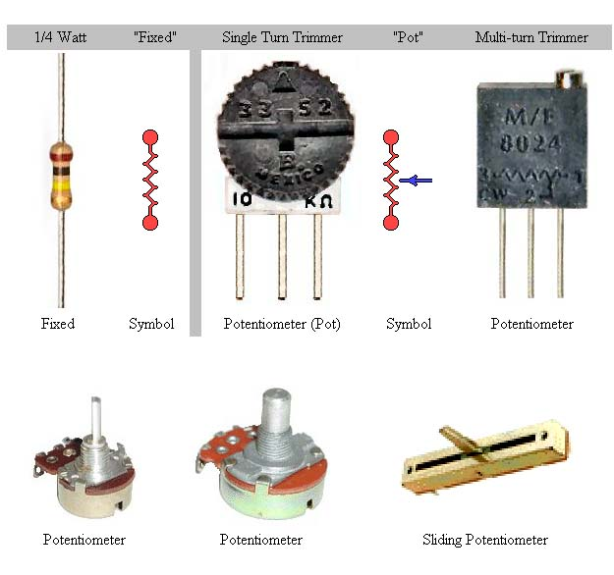
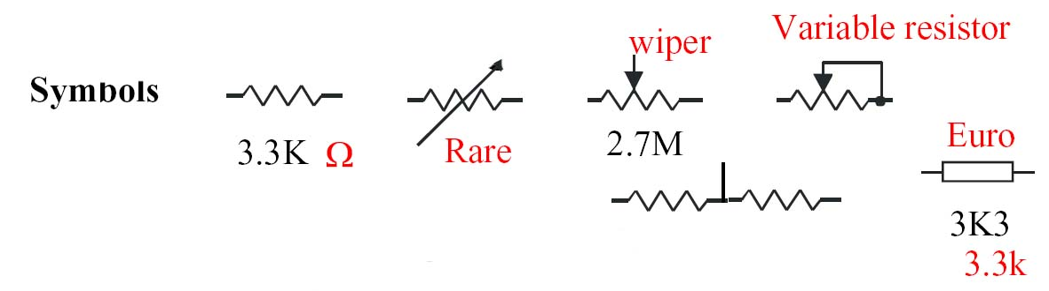
Various resistors types

Slide 14
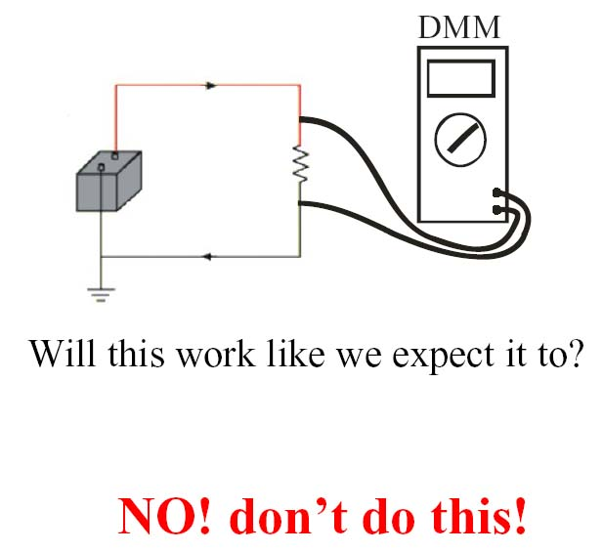
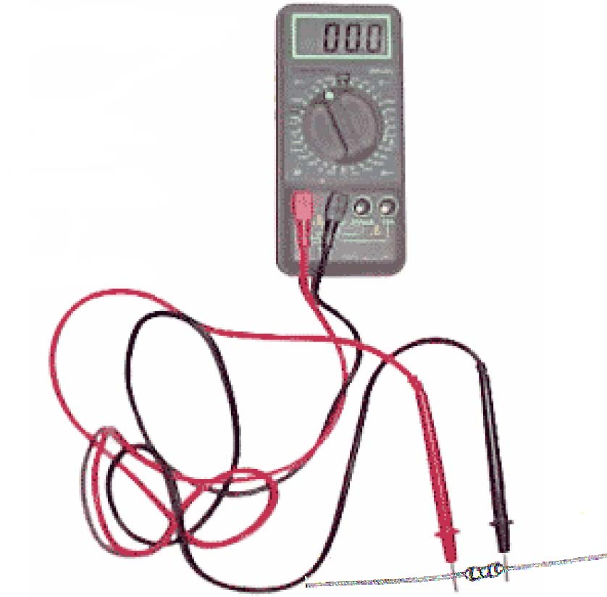
When measuring resistance, remove
component from the circuit.

Slide 15
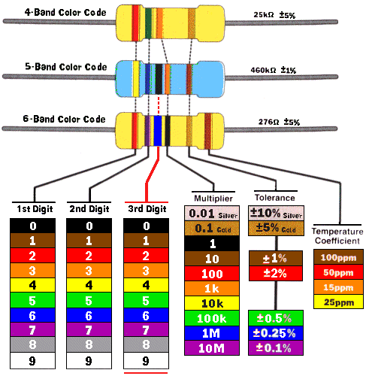
Resistor Color Code

Slide 16
Exercise
Determine the resistance of various resistors of unknown value using the resistor color code
Using the multimeter, compare the specified resistance and measured resistance
Using the multimeter to examine the characteristics of various potentiometers

Slide 17
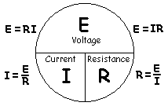
Ohm’s Law

Slide 18
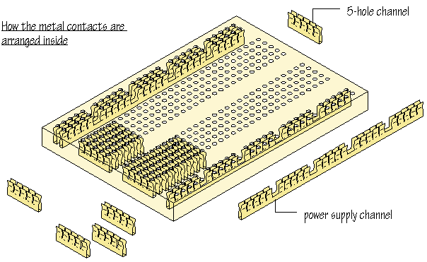
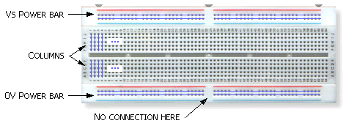
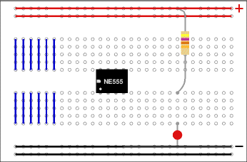
Prototyping Board
Example of how components are
Inserted in the protoboard

Slide 19
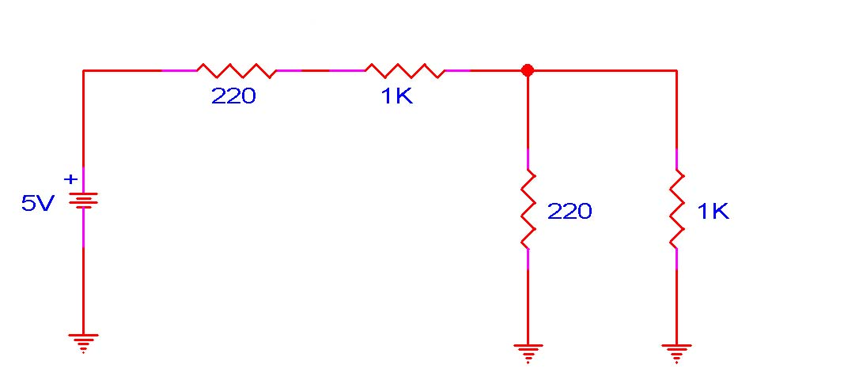
Exercise
Calculate the total current and voltage drop across each resistor shown in Figure 1
Build the circuit in Figure 1 on the prototype board
Measure the total circuit current and voltage drops across each resistor and compare
the calculated and measured values
1k
1k

Slide 20
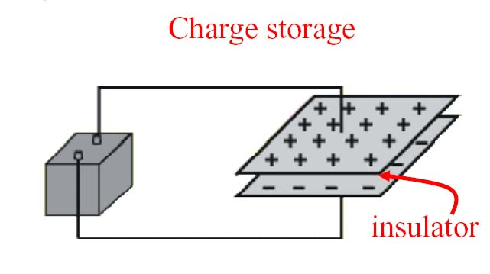
Capacitance
A capacitor is used to store charge for a short amount of time
Capacitor
Battery
Unit = Farad
Pico Farad - pF = 10⁻¹²F
Micro Farad - uF = 10⁻⁶F

Slide 21
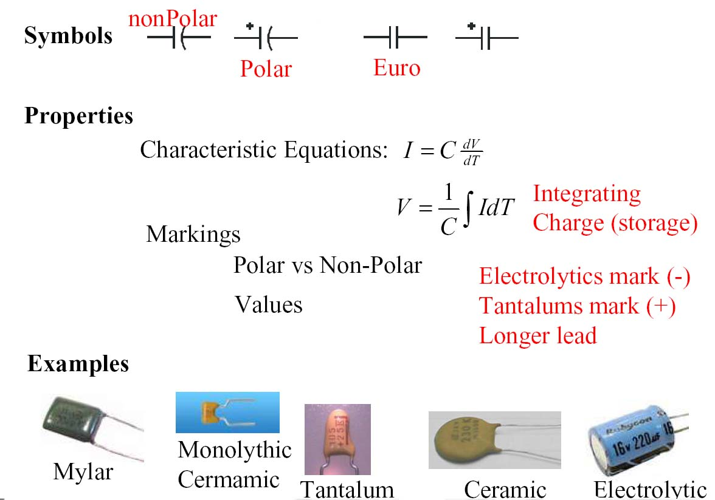

Slide 22
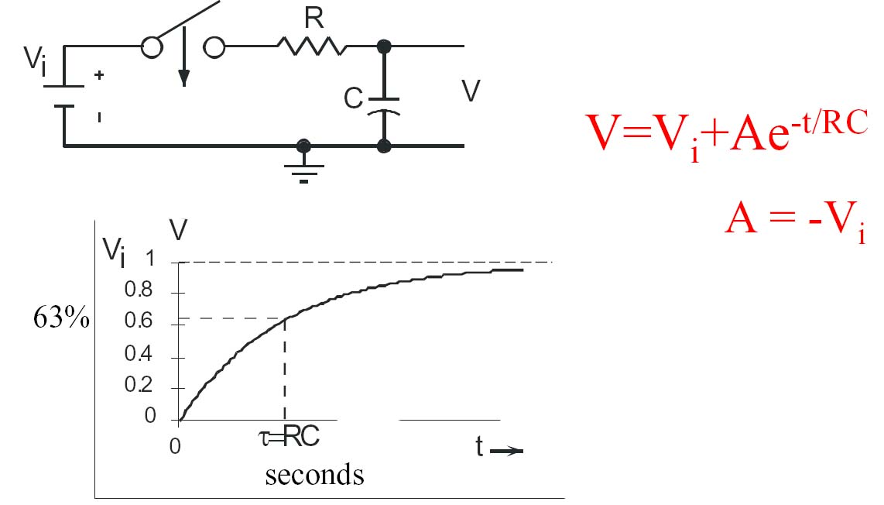
Capacitor Charging

Slide 23
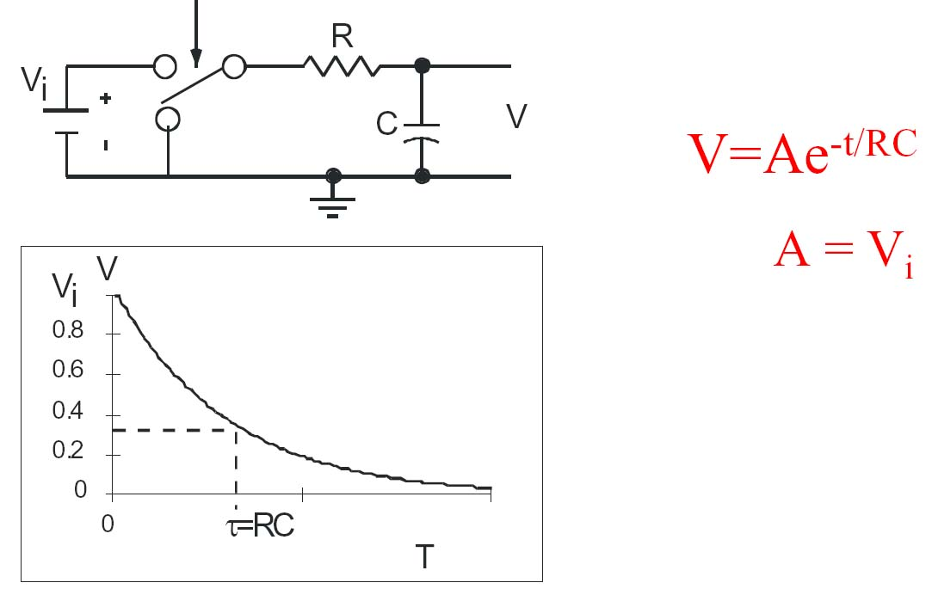
Capacitor Discharge

